Slide 1

(Badan Semi Otonom) ANDROID

Slide 2

Struktural
Ketua : Muhamad Farid Padilah
Sekretaris : Fatimah Hasni
Bendahara : Hadaina Lesta
Manajemen Materi : Banni

Slide 3
Slide Title
SCHEDULE BSO ANDROID SEMESTER GANJIL
Bulan | Tanggal | Materi | Keterangan
SEPTEMBER | 16 | Belajar JAVA | JAVA BASIC
 | 23
 | 30
OKTOBER | 7 | LAYOUTING | ANDROID STUDIO
 | 14
 | 21
 | 28 | LIBUR (UTS)
NOPEMBER | 4 | CODING : BUILD APPS TOGETHER | ANDROID STUDIO
 | 11
 | 18
 | 25
DESEMBER | 2 | TEAMWORK : BUILD APPS
 | 9
 | 16
 | 23
 | 30 | Libur (UAS)

Slide 4

SHARING LEARN

Slide 5
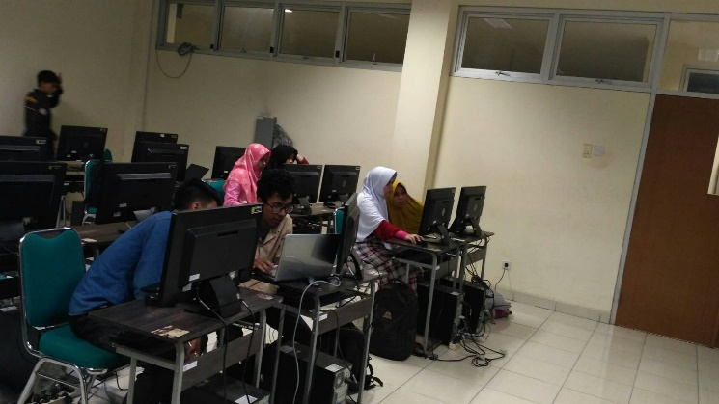
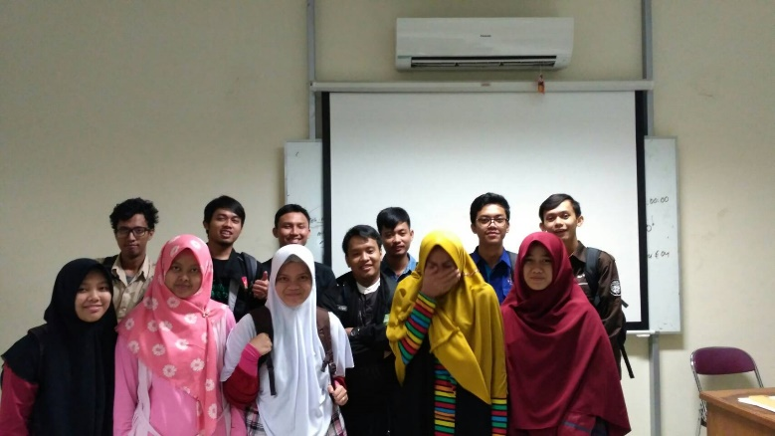
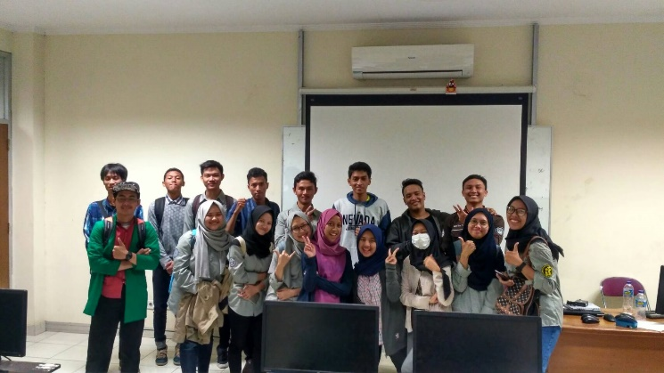
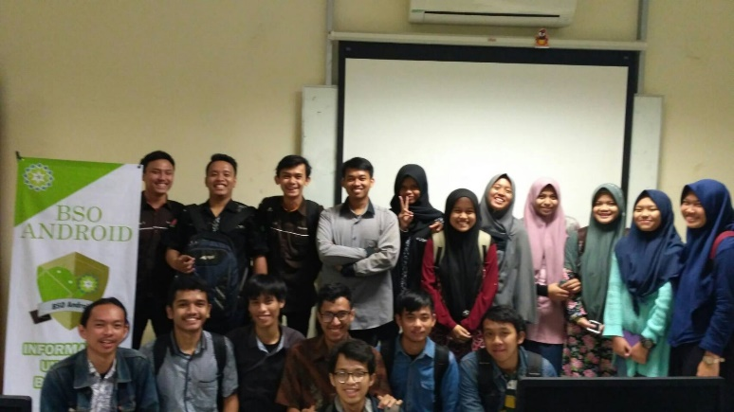
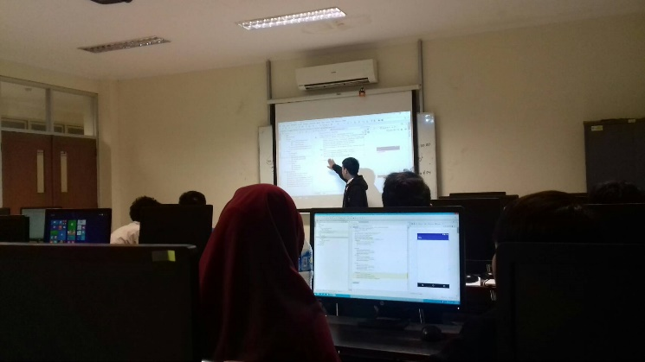
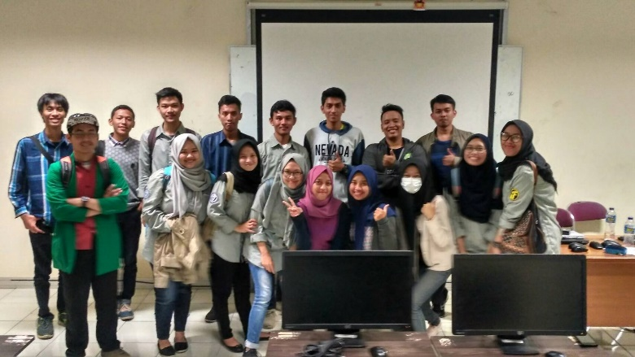

Slide 6
OUR PROJECT
Visit : github.com/BSO-Android

Slide 7
Ada Pertanyaan ?

